Slide 1
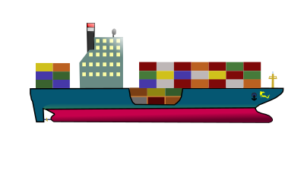
Product Shipment Status Prediction
-Shiva shanth kalkuri

Slide 2

PROBLEM STATEMENT
Developing a machine learning model to accurately predict the product shipment status ,to predict whether the product will deliver on time or not by using past data.

Slide 3
FLOW CHART
DATA COLLECTION
DATA PREPROCESSING
BASE MODEL
CLASS IMBALANCE TREATMENT
EDA-OUTLIERS, SKEWNESS TREATMENT
MODEL BUILDING
SECOND DATAFRAME
FEATURE SELECTION
FINAL DATAFRAME

Slide 4

DATASET INSIGHTS
DATA SHAPE
This dataset contains 10099 rows and 12 columns
TARGET COLUMN
This target variable of this data is “Reached_on_time” which has the values one and zero.
The target variable is categorical.
There are 11 independent columns like Warehouse Block, Cost of the Product, weight of product ,Shipment Mode that impacts the target variable.

Slide 5
DATA PREPROCESSING
NULL VALUE TREATMENT
DATATYPE CONVERSION
COLUMN NAME EDITING

Slide 6
BASE MODEL
MODEL NAME | ACCURACY | TPR | FPR | SPECIFICITY | PRECISION | F1-SCORE
LOGISTIC | 61.863636 | 0.540 | 0.330 | 0.660 | 0.530 | 0.560
DECISION TREE | 65.727273 | 0.540 | 0.300 | 0.710 | 0.570 | 0.600
RANDOM FOREST | 65.954545 | 0.680 | 0.340 | 0.650 | 0.580 | 0.610
KNN | 65.863636 | 0.616 | 0.311 | 0.688 | 0.581 | 0.613
NAÏVE BAYES | 67.454545 | 0.789 | 0.406 | 0.593 | 0.576 | 0.606
SVM | 66.500000 | 0.630 | 0.310 | 0.689 | 0.580 | 0.603
ADA BOOST | 68.227273 | 0.762 | 0.374 | 0.625 | 0.588 | 0.663
XG BOOST | 66.636364 | 0.7530 | 0.387 | 0.612 | 0.573 | 0.647

Slide 7
BASE MODEL CONCLUSION
The ADA Boost model performs the better compared to other models with an accuracy of 68.26%
But all the models are performing underfitting only.

Slide 8
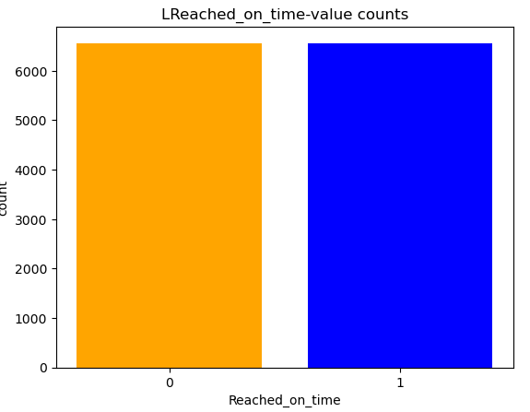
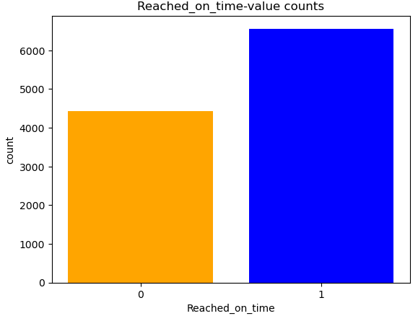
CLASS IMBALANCE
Before Class Imbalance Treatment
After Class Imbalance Treatment

Slide 9
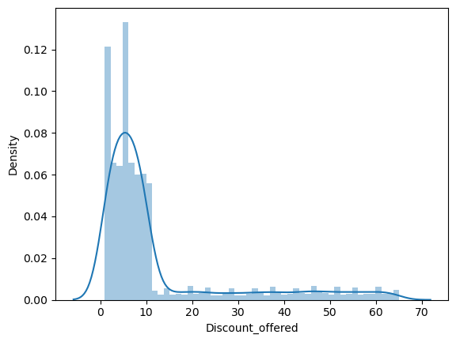
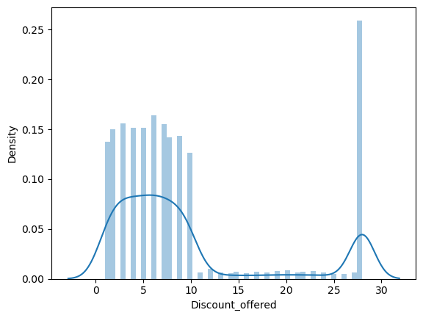
OUTLIER TREATMENT
Before Outlier Treatment
After Outlier Treatment

Slide 10
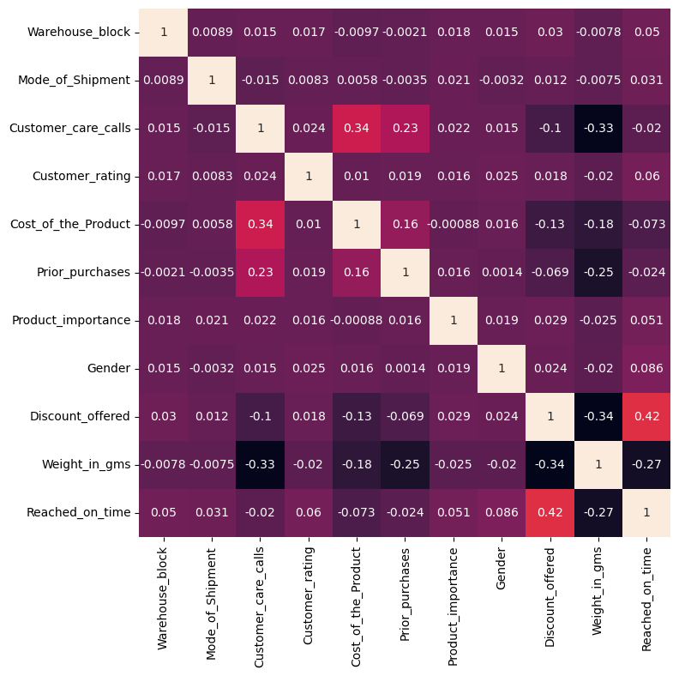
VISUALIZATION

Slide 11
SECOND DATAFRAME
MODEL NAME | ACCURACY | TPR | FPR | SPECIFICITY | PRECISION | F1-SCORE
LOGISTIC | 65.803503 | 0.562 | 0.423 | 0.576 | 0.636 | 0.601
DECISION TREE | 67.821782 | 0.679 | 0.327 | 0.672 | 0.670 | 0.674
RANDOM FOREST | 71.553694 | 0.850 | 0.420 | 0.570 | 0.663 | 0.744
KNN | 71.172887 | 0.824 | 0.387 | 0.612 | 0.676 | 0.742
NAIVE BAYES | 65.536938 | 0.728 | 0.412 | 0.587 | 0.634 | 0.677
SVM | 67.897944 | 0.758 | 0.399 | 0.600 | 0.650 | 0.700
ADA Boost | 71.591775 | 0.930 | 0.484 | 0.515 | 0.654 | 0.767
XG BOOST | 72.619954 | 0.905 | 0.461 | 0.538 | 0.658 | 0.761

Slide 12
DATAFRAME CONCLUSION
After EDA Models performance improved , but still most of the models are performing underfitting
Based on the F1 score, XG Boost is the best model with a score of 0.761 indicating a good balance between precision and recall.
FEATURE SELECTION
Select K Best
RFE Feature Selection
Randomised Search CV

Slide 13
MODEL-DATAFRAME
MODEL NAME | ACCURACY | TPR | FPR | SPECIFICITY | PRECISION | F1-SCORE
LOGISTIC | 65.803503 | 0.562 | 0.423 | 0.576 | 0.636 | 0.601
DECISION TREE | 67.821782 | 0.679 | 0.327 | 0.672 | 0.670 | 0.674
RANDOM FOREST | 71.553694 | 0.850 | 0.420 | 0.570 | 0.663 | 0.744
KNN | 71.172887 | 0.824 | 0.387 | 0.612 | 0.676 | 0.742
NAIVE BAYES | 65.536938 | 0.728 | 0.412 | 0.587 | 0.634 | 0.677
SVM | 67.897944 | 0.758 | 0.399 | 0.600 | 0.650 | 0.700
XG BOOST | 71.591775 | 0.930 | 0.484 | 0.515 | 0.654 | 0.767
ADABOOST | 72.619954 | 0.905 | 0.461 | 0.538 | 0.658 | 0.761
FEATURE SELECTION | 73.2 | 0.920 | 0.460 | 0.530 | 0.660 | 0.768

Slide 14
CONCLUSION
The Feature Selection model performs the best with an accuracy of 73.02%,when compared to other model performances.
Based on the F1 score, Feature Selection is the best model with a score of 0.768 indicating a good balance between precision and recall.

Slide 15
MERITS
This model uses machine learning for Shipment Status Prediction , from which one can analyse the delivery status , whether the product delivered on time or not.
Enhance customer satisfaction with this delivery status prediction tool.

Slide 16
DEMERITS
The data has more no of less importance columns ,which directly impacted Models performance

Slide 17

This Photo by Unknown Author is licensed under CC BY

